Slide 1
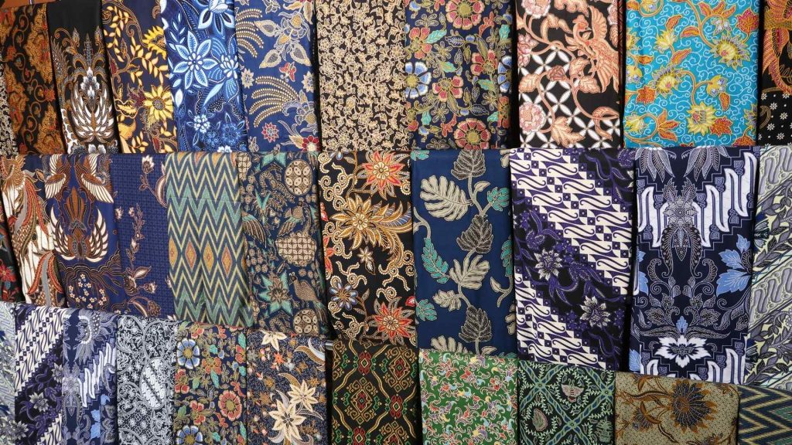
How Indonesia Gave a New Life to its Dying Batik Industry
Notes:
Image: https://www.google.com/url?sa=i&url=https%3A%2F%2Fashabatik.com%2F2022%2F09%2F21%2Findonesian-batik-fabric-for-canada%2F&psig=AOvVaw0iFPvWV0LJILFxYkSFIO7U&ust=1726215136516000&source=images&cd=vfe&opi=89978449&ved=0CBgQ3YkBahgKEwjQzbTT-ryIAxUAAAAAHQAAAAAQhwI

Slide 2
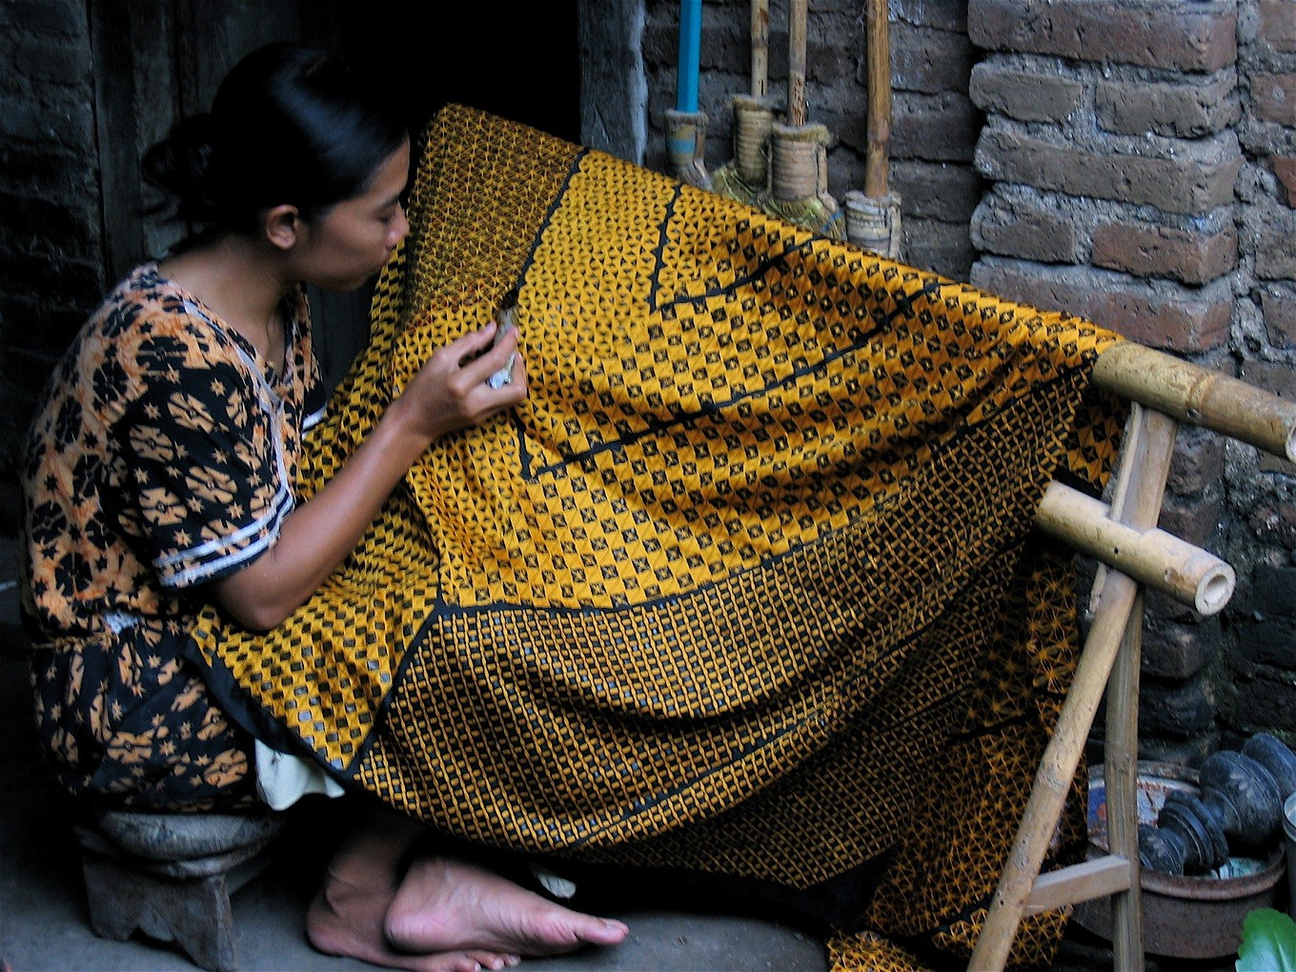
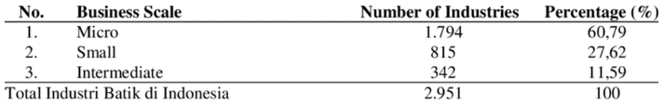
Batik Textiles
1000+ year history in Indonesia
Fabric designed using wax-resist technique
This craft became a symbol for Indonesia’s national identity during Indonesia’s freedom struggle
40,000 people in workforce. Mostly micro and small family businesses.
Total (2021):
Notes:
Sources:
“UNESCO - Indonesian Batik.” Accessed September 10, 2024. https://ich.unesco.org/en/RL/indonesian-batik-00170.
Febriani, Rina, Luuk Knippenberg, and Noelle Aarts. “The Making of a National Icon: Narratives of Batik in Indonesia.” Cogent Arts & Humanities 10, no. 1 (December 31, 2023): 2254042. https://doi.org/10.1080/23311983.2023.2254042.
ResearchGate. “Number of Batik Industries by Business Scale in Indonesia in 2021.” Accessed September 11, 2024. https://www.researchgate.net/figure/Number-of-Batik-Industries-by-Business-Scale-in-Indonesia-in-2021_tbl1_375499598.
Nuriyanto, Lilam Kadarin. “Preservation of the Batik Industry in Indonesia as Part of the National Identity.” International Journal of Science and Applied Science: Conference Series 6, no. 2 (2022).
Image from: https://www.google.com/url?sa=i&url=https%3A%2F%2Fwww.thejakartapost.com%2Flife%2F2017%2F11%2F02%2Fus-filmmaker-showcases-batik-making-process-in-batik-of-java.html&psig=AOvVaw3y2guLGYTVVagTK5syxmOD&ust=1726210104388000&source=images&cd=vfe&opi=89978449&ved=0CBcQjhxqFwoTCKjrt_LnvIgDFQAAAAAdAAAAABAJ

Slide 3

Batik Industry Decline
01 Outdated The industry was not updated to fit modern aesthetic standards and clothing habits. Batik was used in formal, ceremonial occasions, which excluded it from daily wear.
02 Irregular Income Traditionally a family business, younger generations are deterred by the low wages and irregular income.
03 Lack of Market Access Tourists and international buyers value handicrafts for their cultural significance and are willing to pay more, but Indonesian artisans are limited to local market connections.
Notes:
Sources:
Background image: https://stock.adobe.com/in/images/modern-motifs-design-for-java-batik-with-seamless-soft-brown-color-design/345031535
Famiola, Melia. “The Social Constructivism of Entreprenurial Process in SMEs Revitalization: A Case of Batik Industry in Indonesia.” Academy of Entrepreneurship Journal 27, no. 5S (September 6, 2021): 1–12.
Nugroho, Prihadi, Maya Damayanti, Artiningsih Artiningsih, Dwi Lestari, and Novita Rohmana Putri. “Missing Policy for Supporting Cultural Heritage Preservation of Batik Industry Clusters in Barlingmascakeb Region, Indonesia.” IOP Conference Series: Earth and Environmental Science 1082, no. 1 (September 2022): 012017. https://doi.org/10.1088/1755-1315/1082/1/012017.
Nuriyanto, Lilam Kadarin. “Preservation of the Batik Industry in Indonesia as Part of the National Identity.” International Journal of Science and Applied Science: Conference Series 6, no. 2 (2022).
“Crafting Futures Research: ‘Mapping of New Materials and Repurposing of Existing Materials in Indonesia’s Craft Sector.’” British Council, Budaya Kreatif Foundation, Bandung Institute of Technology and the University of Leeds. Accessed September 10, 2024. https://www.britishcouncil.id/sites/default/files/crafting_futures_full_research_english_compressed.pdf.
Ballard Brief. “Income Instability Among Artisans in South Asia.” Accessed September 11, 2024. https://ballardbrief.byu.edu/issue-briefs/income-instability-among-artisans-in-south-asia.

Slide 4
Revitalization Strategy
Tourism Development
Public Promotion & Education
Training & Technical Assistance
Supportive Policy Framework
Notes:
Sources:
Batik museum image: https://visitjawatengah.jatengprov.go.id/en/destinations/museum-batik-pekalongan
Batik carnival image: https://indonesiakaya.com/pustaka-indonesia/parade-kreasi-batik-dalam-solo-batik-carnival/
Batik village image: https://visitjawatengah.jatengprov.go.id/en/shopping/laweyan-batik-village
Nuriyanto, Lilam Kadarin. “Preservation of the Batik Industry in Indonesia as Part of the National Identity.” International Journal of Science and Applied Science: Conference Series 6, no. 2 (2022).
Febriani, Rina, Luuk Knippenberg, and Noelle Aarts. “The Making of a National Icon: Narratives of Batik in Indonesia.” Cogent Arts & Humanities 10, no. 1 (December 31, 2023): 2254042. https://doi.org/10.1080/23311983.2023.2254042.
Sugiyanto, and Ihsan Budi Santoso. “Batik: Object and Tourist Attraction,” 314–17. Atlantis Press, 2019. https://www.atlantis-press.com/proceedings/isot-18/125909405.
“A Look into Indonesia’s Oldest Batik-Producing Region | Daily Sabah.” Accessed September 11, 2024. https://www.dailysabah.com/gallery/a-look-into-indonesias-oldest-batik-producing-region/images.
Google Arts & Culture. “Batik Villages and Inspirational Batik Makers.” Accessed September 11, 2024. https://artsandculture.google.com/story/batik-villages-and-inspirational-batik-makers/LQVBAiumeXyJKQ.

Slide 5
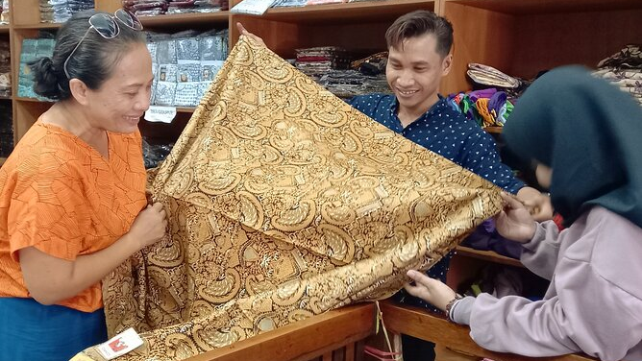
Tourism Development
The Indonesian government and private sector promote textile tourism through handicraft villages that concentrate Batik production and tourism opportunities.
Notes:
Sources:
Image: https://www.tripadvisor.in/AttractionProductReview-g297694-d24958550-Well_Guided_Local_Textile_Tour_of_Denpasar-Denpasar_Bali.html
https://www.indonesia.travel/in/en/trip-ideas/discover-the-art-of-hand-weaving-at-these-indonesian-villages.html
https://www.adventure-life.com/indonesia/cruises/15341/the-textiles-of-the-lesser-sundas
https://www.stitchtopia.co.uk/holiday/textiles-of-Indonesia
https://www.asiantextilestudies.com/tour.html
Nuriyanto, Lilam Kadarin. “Preservation of the Batik Industry in Indonesia as Part of the National Identity.” International Journal of Science and Applied Science: Conference Series 6, no. 2 (2022).
Febriani, Rina, Luuk Knippenberg, and Noelle Aarts. “The Making of a National Icon: Narratives of Batik in Indonesia.” Cogent Arts & Humanities 10, no. 1 (December 31, 2023): 2254042. https://doi.org/10.1080/23311983.2023.2254042.
Sugiyanto, and Ihsan Budi Santoso. “Batik: Object and Tourist Attraction,” 314–17. Atlantis Press, 2019. https://www.atlantis-press.com/proceedings/isot-18/125909405.
“A Look into Indonesia’s Oldest Batik-Producing Region | Daily Sabah.” Accessed September 11, 2024. https://www.dailysabah.com/gallery/a-look-into-indonesias-oldest-batik-producing-region/images.
Google Arts & Culture. “Batik Villages and Inspirational Batik Makers.” Accessed September 11, 2024. https://artsandculture.google.com/story/batik-villages-and-inspirational-batik-makers/LQVBAiumeXyJKQ

Slide 6
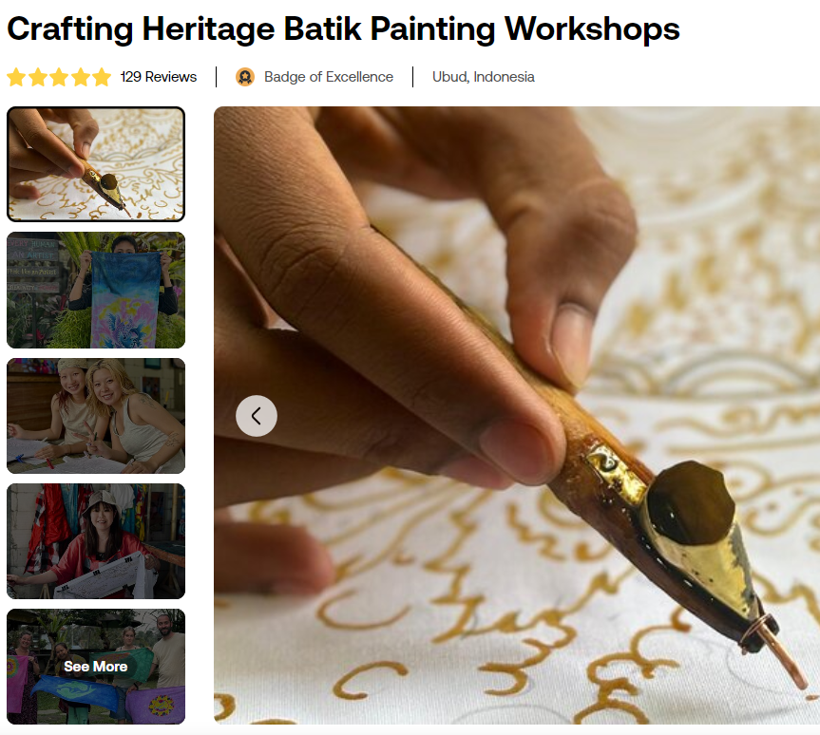
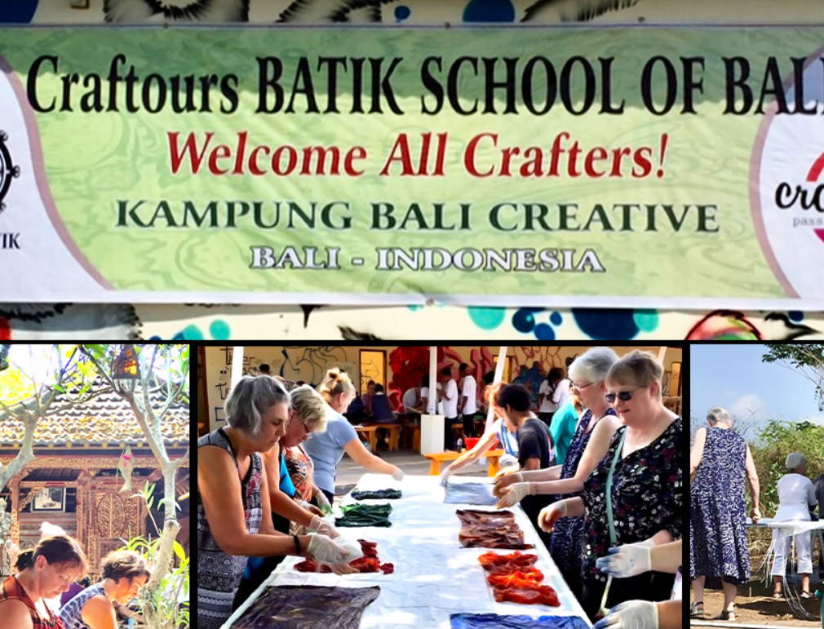
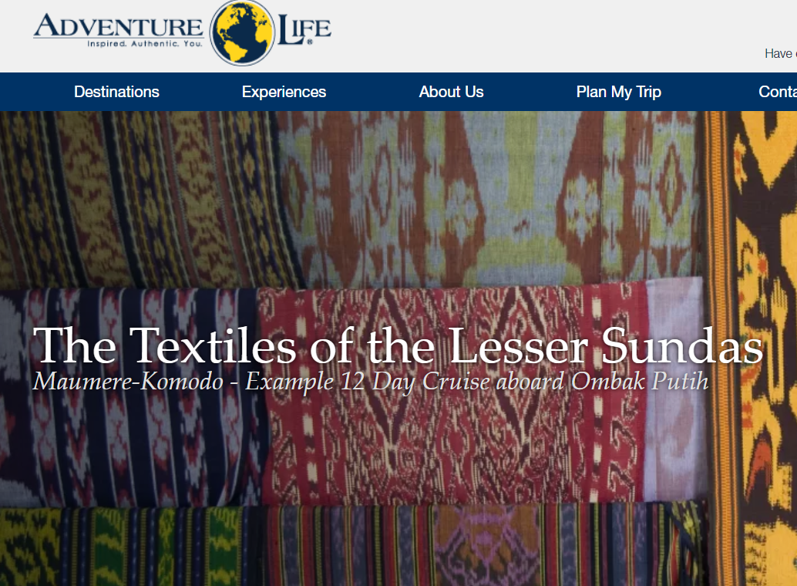
Batik Tours
Many agencies offer textile tours, workshops, and trips designed to spotlight the world of Indonesian fabrics.
Notes:
https://www.viator.com/en-IN/tours/Ubud/Create-your-own-handmade-Batik-painting/d5467-66708P2
https://www.craftours.com/tourcat/batik/
https://www.adventure-life.com/indonesia/cruises/15341/the-textiles-of-the-lesser-sundas
Nuriyanto, Lilam Kadarin. “Preservation of the Batik Industry in Indonesia as Part of the National Identity.” International Journal of Science and Applied Science: Conference Series 6, no. 2 (2022).
Febriani, Rina, Luuk Knippenberg, and Noelle Aarts. “The Making of a National Icon: Narratives of Batik in Indonesia.” Cogent Arts & Humanities 10, no. 1 (December 31, 2023): 2254042. https://doi.org/10.1080/23311983.2023.2254042.
Sugiyanto, and Ihsan Budi Santoso. “Batik: Object and Tourist Attraction,” 314–17. Atlantis Press, 2019. https://www.atlantis-press.com/proceedings/isot-18/125909405.
“A Look into Indonesia’s Oldest Batik-Producing Region | Daily Sabah.” Accessed September 11, 2024. https://www.dailysabah.com/gallery/a-look-into-indonesias-oldest-batik-producing-region/images.
Google Arts & Culture. “Batik Villages and Inspirational Batik Makers.” Accessed September 11, 2024. https://artsandculture.google.com/story/batik-villages-and-inspirational-batik-makers/LQVBAiumeXyJKQ

Slide 7

Public Promotion & Education
The UNESCO Representative List of Intangible Cultural Heritage spotlights global traditions.
Batik earned its place on October 2, 2009, celebrated annually as ‘Batik Day.’
Notes:
Sources:
UNESCO Intangible Heritage logo: https://ich.unesco.org/en/lists
Febriani, Rina, Luuk Knippenberg, and Noelle Aarts. “The Making of a National Icon: Narratives of Batik in Indonesia.” Cogent Arts & Humanities 10, no. 1 (December 31, 2023): 2254042. https://doi.org/10.1080/23311983.2023.2254042.
Nuriyanto, Lilam Kadarin. “Preservation of the Batik Industry in Indonesia as Part of the National Identity.” International Journal of Science and Applied Science: Conference Series 6, no. 2 (2022).

Slide 8
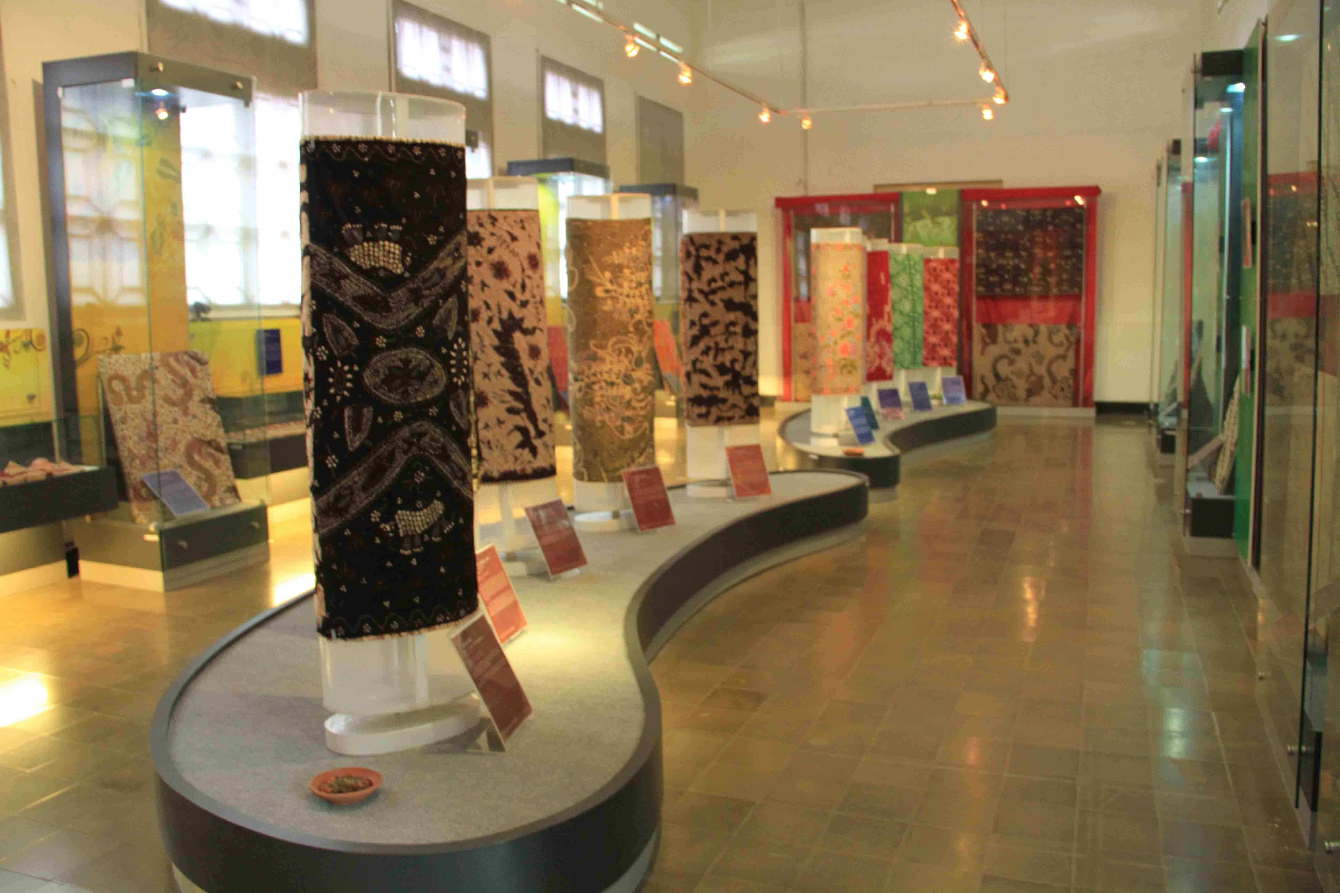
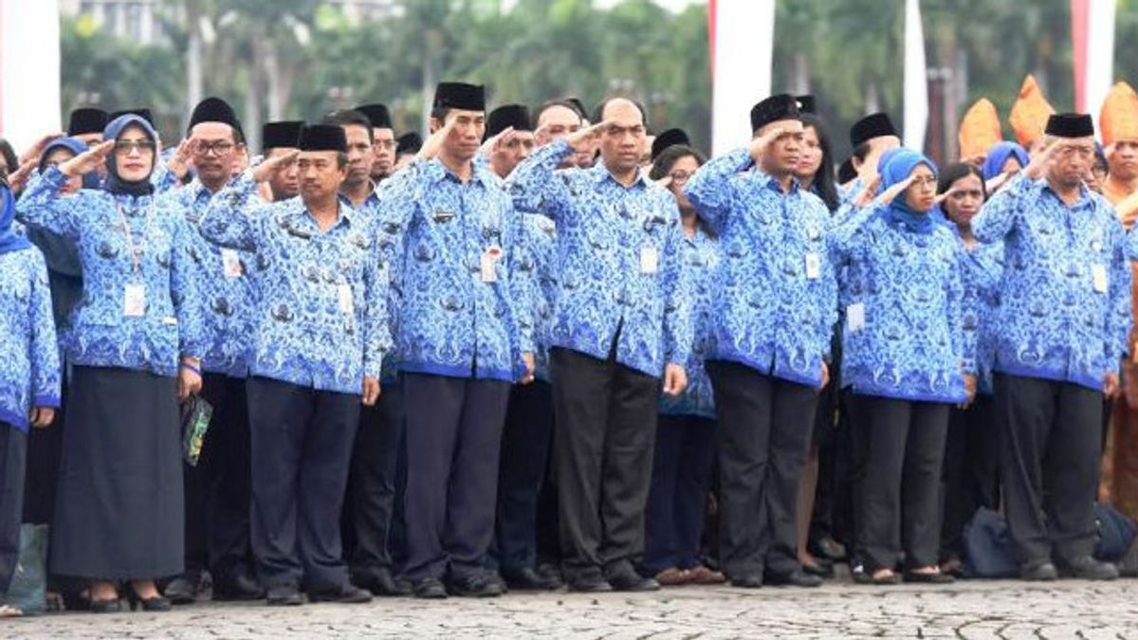
Targeted promotion and education efforts, including Batik Day, mandatory Batik uniforms, museums and Batik-themed events.
Pekalongan Batik Museum
Local gov’ts require Batik uniforms on certain days
Notes:
Sources:
Batik museum image: https://visitjawatengah.jatengprov.go.id/en/destinations/museum-batik-pekalongan
Batik uniform image: https://voi.id/en/news/8952
Nuriyanto, Lilam Kadarin. “Preservation of the Batik Industry in Indonesia as Part of the National Identity.” International Journal of Science and Applied Science: Conference Series 6, no. 2 (2022).
Febriani, Rina, Luuk Knippenberg, and Noelle Aarts. “The Making of a National Icon: Narratives of Batik in Indonesia.” Cogent Arts & Humanities 10, no. 1 (December 31, 2023): 2254042. https://doi.org/10.1080/23311983.2023.2254042.
Sugiyanto, and Ihsan Budi Santoso. “Batik: Object and Tourist Attraction,” 314–17. Atlantis Press, 2019. https://www.atlantis-press.com/proceedings/isot-18/125909405.
“A Look into Indonesia’s Oldest Batik-Producing Region | Daily Sabah.” Accessed September 11, 2024. https://www.dailysabah.com/gallery/a-look-into-indonesias-oldest-batik-producing-region/images.
Google Arts & Culture. “Batik Villages and Inspirational Batik Makers.” Accessed September 11, 2024. https://artsandculture.google.com/story/batik-villages-and-inspirational-batik-makers/LQVBAiumeXyJKQ.

Slide 9
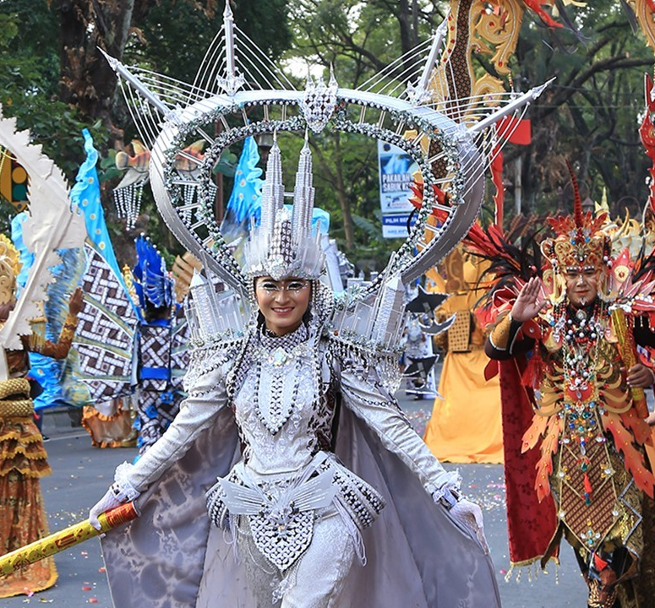
Surakarta, Yogyakarta, Pekalongan, and Lasem have become batik hotspots, hosting vibrant events like Solo Batik Carnival, Jogja Fashion Week, and International Batik Week.
Solo Batik Carnival
Notes:
Sources: - https://www.silverkris.com/inspiration/arts-culture/heritage/tradition-batik-kept-alive-solo-central-javas-lesser-known-royal-city/
Nuriyanto, Lilam Kadarin. “Preservation of the Batik Industry in Indonesia as Part of the National Identity.” International Journal of Science and Applied Science: Conference Series 6, no. 2 (2022).
Febriani, Rina, Luuk Knippenberg, and Noelle Aarts. “The Making of a National Icon: Narratives of Batik in Indonesia.” Cogent Arts & Humanities 10, no. 1 (December 31, 2023): 2254042. https://doi.org/10.1080/23311983.2023.2254042.
Sugiyanto, and Ihsan Budi Santoso. “Batik: Object and Tourist Attraction,” 314–17. Atlantis Press, 2019. https://www.atlantis-press.com/proceedings/isot-18/125909405.
“A Look into Indonesia’s Oldest Batik-Producing Region | Daily Sabah.” Accessed September 11, 2024. https://www.dailysabah.com/gallery/a-look-into-indonesias-oldest-batik-producing-region/images.
Google Arts & Culture. “Batik Villages and Inspirational Batik Makers.” Accessed September 11, 2024. https://artsandculture.google.com/story/batik-villages-and-inspirational-batik-makers/LQVBAiumeXyJKQ.

Slide 10
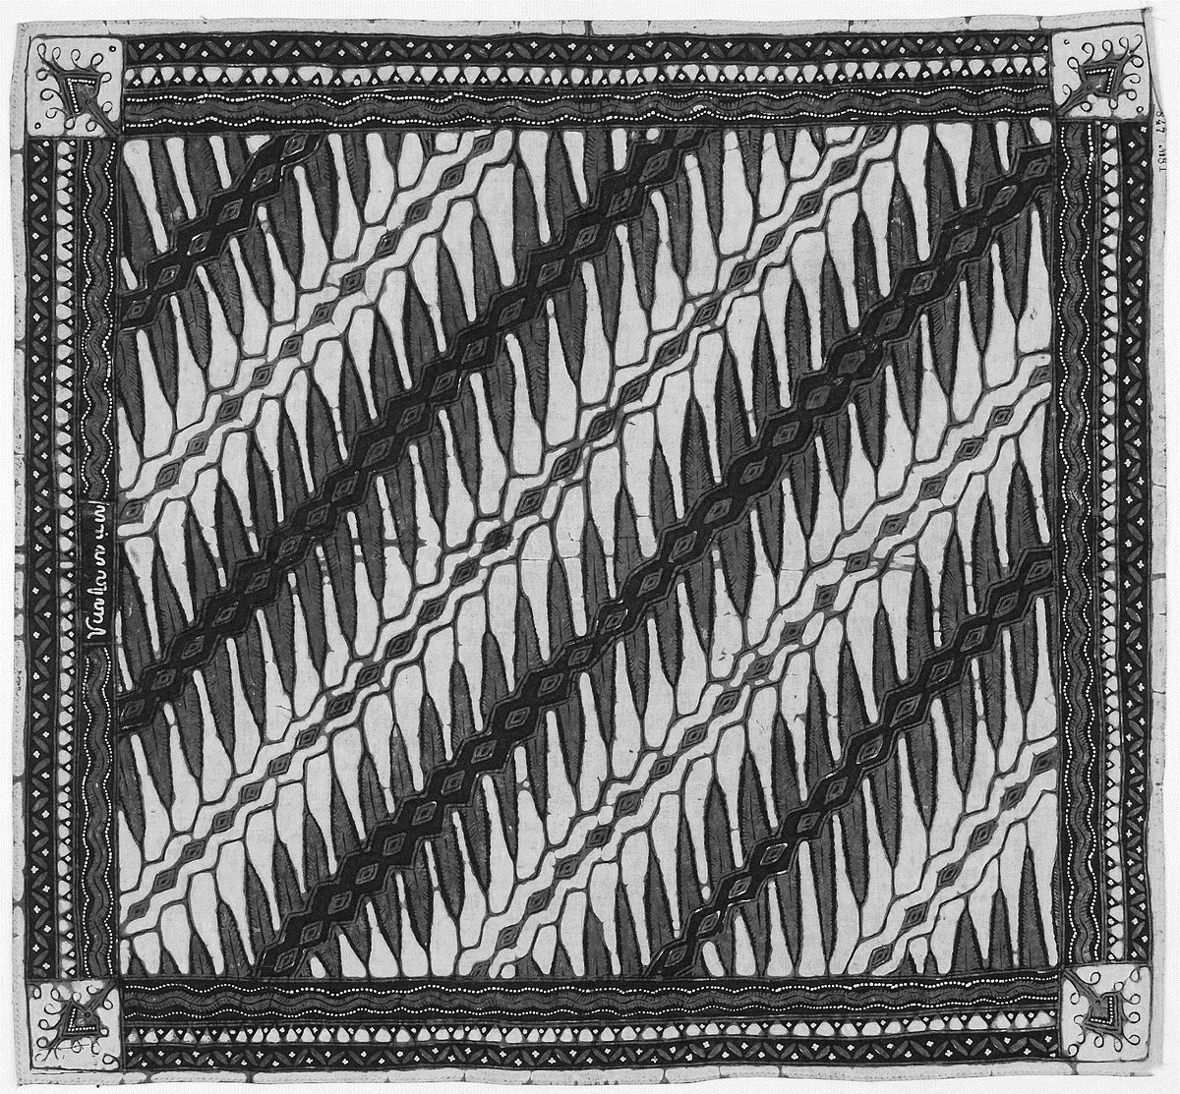
Training & Technical Assistance to Artisans
Patent Training
Screen-printing Technology
Providing Equipment and Raw Materials
Notes:
Sources:
Image: https://en.wikipedia.org/wiki/Batik
“Crafting Futures Research: ‘Mapping of New Materials and Repurposing of Existing Materials in Indonesia’s Craft Sector.’” British Council, Budaya Kreatif Foundation, Bandung Institute of Technology and the University of Leeds. Accessed September 10, 2024. https://www.britishcouncil.id/sites/default/files/crafting_futures_full_research_english_compressed.pdf.
Nugroho, Prihadi, Maya Damayanti, Artiningsih Artiningsih, Dwi Lestari, and Novita Rohmana Putri. “Missing Policy for Supporting Cultural Heritage Preservation of Batik Industry Clusters in Barlingmascakeb Region, Indonesia.” IOP Conference Series: Earth and Environmental Science 1082, no. 1 (September 2022): 012017. https://doi.org/10.1088/1755-1315/1082/1/012017.
Nuriyanto, Lilam Kadarin. “Preservation of the Batik Industry in Indonesia as Part of the National Identity.” International Journal of Science and Applied Science: Conference Series 6, no. 2 (2022).

Slide 11


Supportive Policy Framework
Creative Economy Law (2019) regulates handicrafts and provides artisans with the right to local/central government support.
Local policies, spatial, and sectoral plans include Batik.
Notes:
Sources:
“Crafting Futures Research: ‘Mapping of New Materials and Repurposing of Existing Materials in Indonesia’s Craft Sector.’” British Council, Budaya Kreatif Foundation, Bandung Institute of Technology and the University of Leeds. Accessed September 10, 2024. https://www.britishcouncil.id/sites/default/files/crafting_futures_full_research_english_compressed.pdf.
Nugroho, Prihadi, Maya Damayanti, Artiningsih Artiningsih, Dwi Lestari, and Novita Rohmana Putri. “Missing Policy for Supporting Cultural Heritage Preservation of Batik Industry Clusters in Barlingmascakeb Region, Indonesia.” IOP Conference Series: Earth and Environmental Science 1082, no. 1 (September 2022): 012017. https://doi.org/10.1088/1755-1315/1082/1/012017.
Nuriyanto, Lilam Kadarin. “Preservation of the Batik Industry in Indonesia as Part of the National Identity.” International Journal of Science and Applied Science: Conference Series 6, no. 2 (2022).

Slide 12
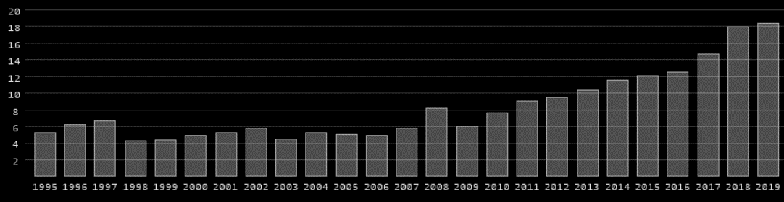
Results
Increase in Tourism Revenues: 3.5X
Increase in Production Value: 20X
Annual Tourism Revenues in Indonesia in Billion USD
Notes:
Source: https://www.worlddata.info/asia/indonesia/tourism.php#:~:text=In%202021%2C%20Indonesia%20generated%20around,tourism%20receipts%20in%20Southeast%20Asia.

Slide 13
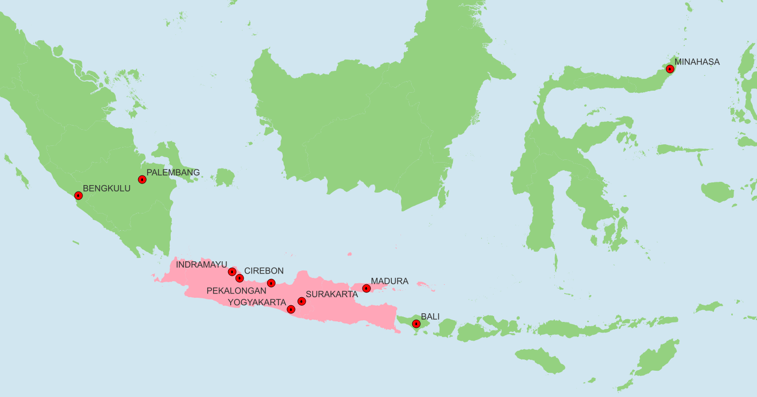
80% of Batik is produced within the central island of Java (in pink).
This map marks 10 major Batik production centers.
Notes:
Sources:
Nuriyanto, Lilam Kadarin. “Preservation of the Batik Industry in Indonesia as Part of the National Identity.” International Journal of Science and Applied Science: Conference Series 6, no. 2 (2022).
Authentic Indonesia. “10 Most Popular Batik Production Center in Indonesia | Authentic Indonesia Blog.” Accessed September 10, 2024. https://authentic-indonesia.com/blog/10-most-popular-batik-production-center-in-indonesia/.
Map shapefiles from: https://imcarto.webflow.io/gdb

Slide 14
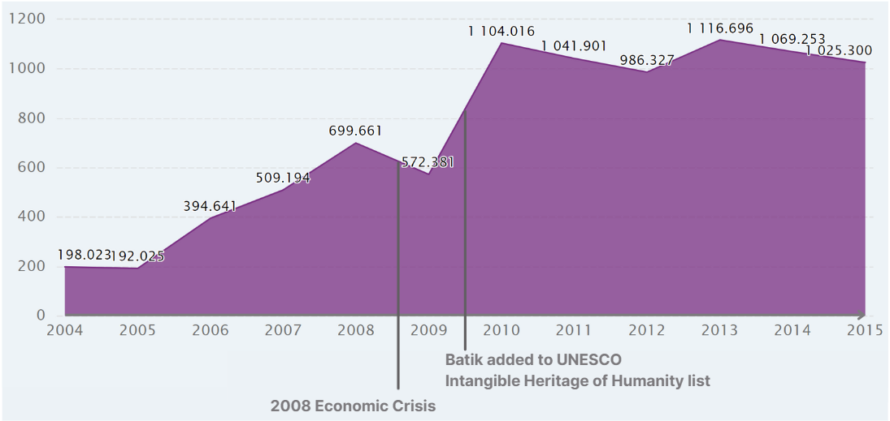
Production Value of Batik Industry (Billion Indonesian Rupiah) 2004-15
2015 annual production value was 1 trillion rupiah.
Now, annual production value has more than quadrupled at 4.89 trillion rupiahs (317 million USD).
Notes:
Sources:
Nuriyanto, Lilam Kadarin. “Preservation of the Batik Industry in Indonesia as Part of the National Identity.” International Journal of Science and Applied Science: Conference Series 6, no. 2 (2022).
ResearchGate. “Number of Batik Industries by Business Scale in Indonesia in 2021.” Accessed September 11, 2024. https://www.researchgate.net/figure/Number-of-Batik-Industries-by-Business-Scale-in-Indonesia-in-2021_tbl1_375499598.
“Indonesia Manufacturing Industry: Production: Value: Batik | Economic Indicators | CEIC.” Accessed September 11, 2024. https://www.ceicdata.com/en/indonesia/manufacturing-industry-by-product-value/manufacturing-industry-production-value-batik.

Slide 15
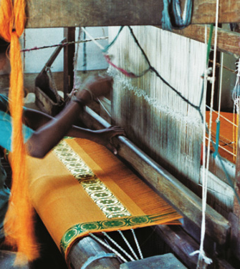
Learning for Indian Handicrafts and Handloom Sector
Successful handicraft strategy involves both supply and demand-side interventions.
Batik’s inclusion in UNESCO’s Intangible Cultural Heritage list sparked global and local interest.
Demand surged through Batik-themed Events like Batik Day, local icons, fairs, and museums.
Artisans empowered with patent training, supportive policies for SMEs, and skill-building programs.
Notes:
Sources:
Famiola, Melia. “The Social Constructivism of Entreprenurial Process in SMEs Revitalization: A Case of Batik Industry in Indonesia.” Academy of Entrepreneurship Journal 27, no. 5S (September 6, 2021): 1–12.
Image: https://gaatha.com/textiles-of-andhra/

